Slide 1
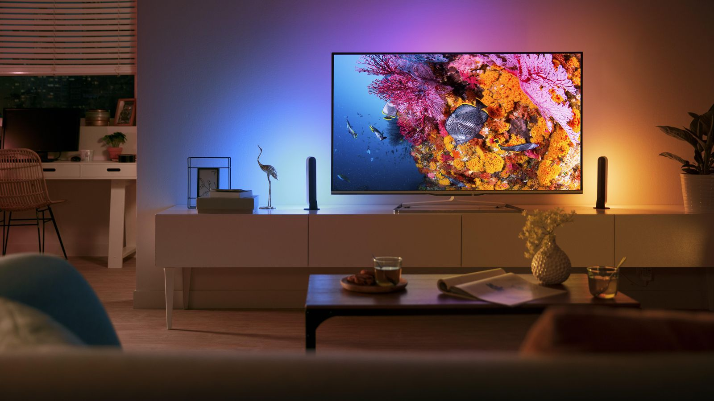
Fund Time
Together,
We Strong
Nawang Tendar 2018 – 2019 Web Development

Slide 2


Slide 3
Probleem
Innovatieve ideeën sterven af door financial probleem

Slide 4

Oplossing
Financial steun vragen aan de wereld
Alle backers krijgen een cadeautje terug van project creator

Slide 5
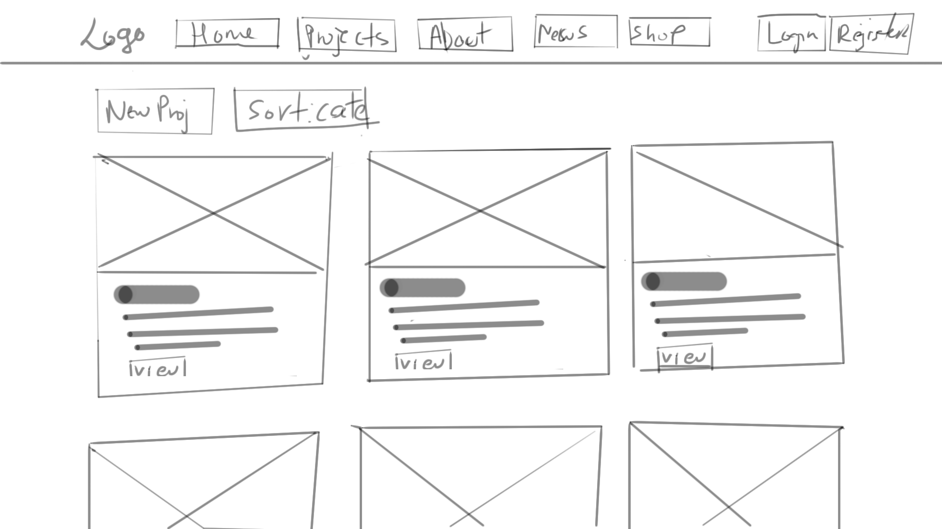

Slide 6
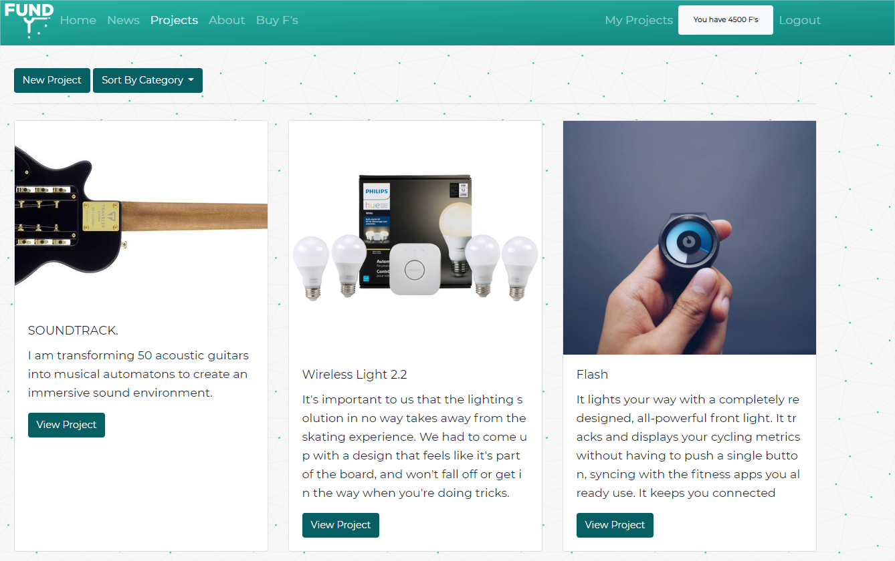

Slide 7

USER POWER
Create new projects
Fund other projects
Comments
Control own project
Download in PDF

Slide 8
DATABASE
Tabellen
Tabellen – M 2 M
Users
News
Projects
Pledges
Pages
Backers
Comments
Categories
Shop_Items
Project_Images
Category_Project

Slide 9

Routes
Main Routes
Projects
News
Pages
Shop
Category Sorted
Auth

Slide 10
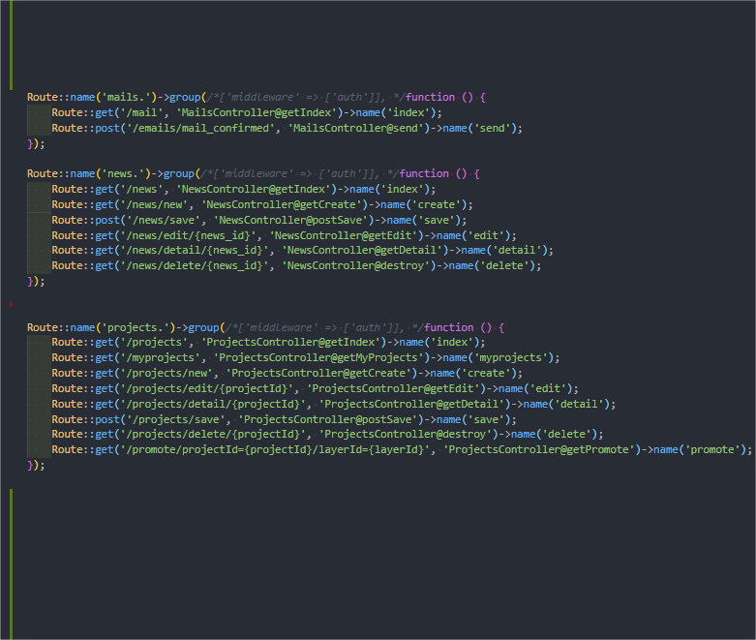
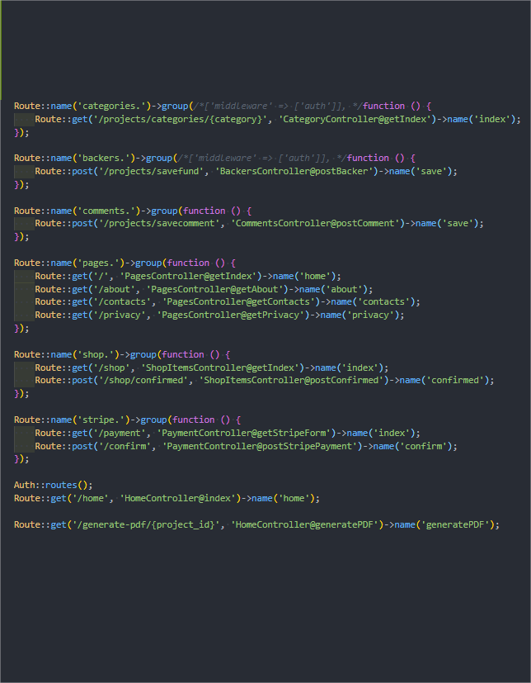

Slide 11
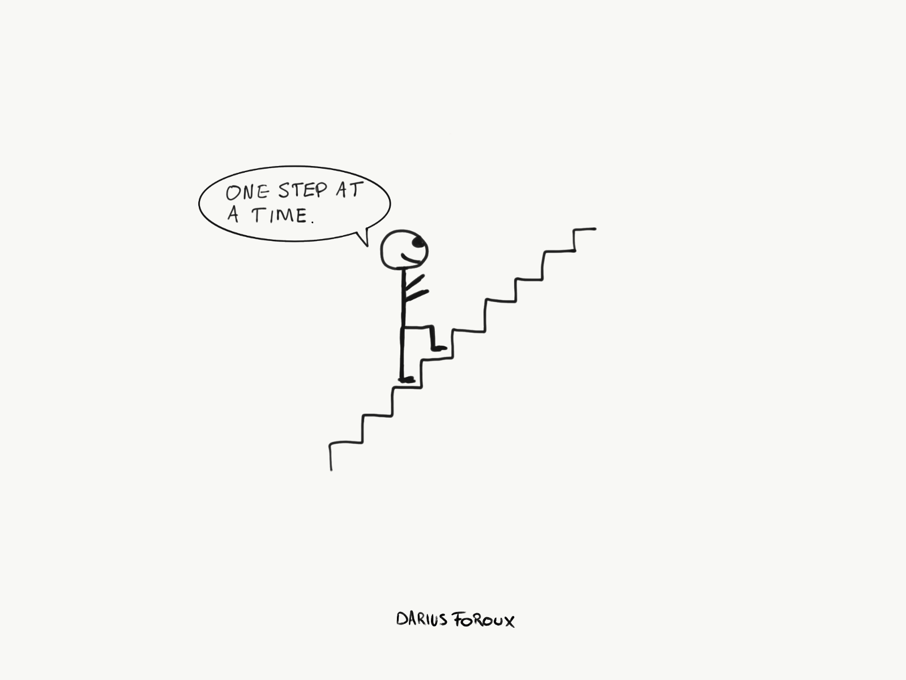
Tijdens development: fouten
Consistentie
Te vroeg begonnen

Slide 12
DEMO
Lets get real

Slide 13
Thank you
Questions?

